Slide 1

DATA MINING USING RAPIDMINER
Rekha Remadevi

Slide 2
objective
USE OF DATA MINING TECHNIQUES
TO Investigate Customer buying patterns
predict New Product Profitability

Slide 3
Why Data Mining?
Data mining is widely considered necessary in many business applications for effective decision-making.
Through modeling and predictive analytics, the firm can forecast the performance of the product(s)
It helps marketing professionals improve their understanding of customer behavior. In turn, this better understanding allows them to target marketing campaigns more accurately and to align campaigns more closely with the needs, wants and attitudes of customers and prospects.

Slide 4
General Overview of the Data
Provided data had attributes like regional spread – 4 regions, spending profile, age profile and purchasing profile.
Pattern of sales for existing products
List of new products for potential introduction to the market

Slide 5
Customer Buying Patterns

Slide 6
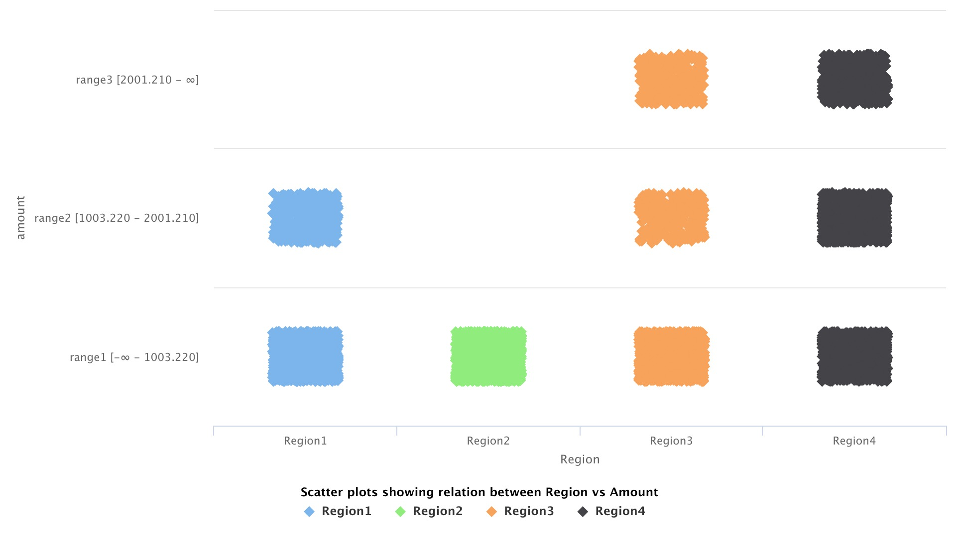
Overview of regional spend per transaction
Question:
Do customers in different regions spend more per transaction?
Finding:
Despite online or in store, Region 4 seems to spend more on purchases compared to the other regions with Region 3 right behind.

Slide 7
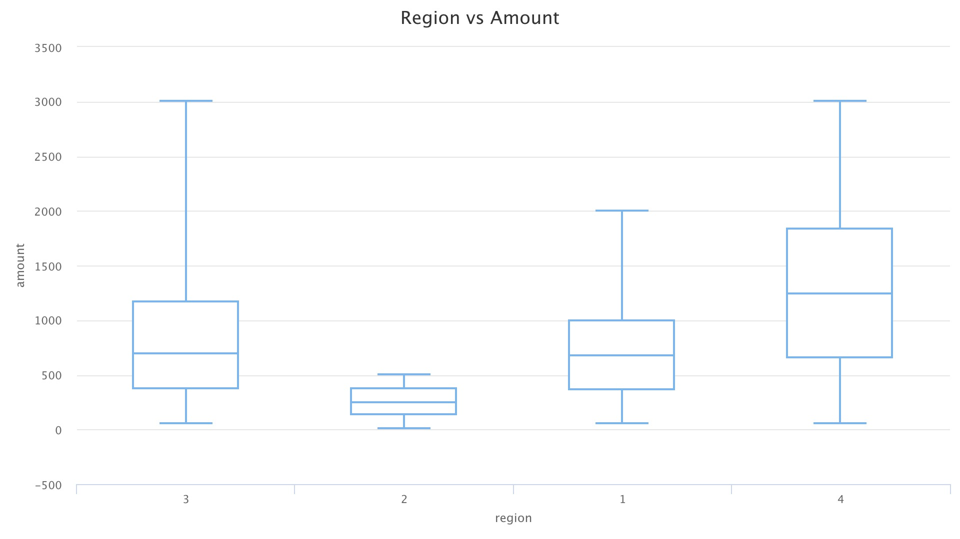
Median = 1247
Median = 700
Median = 650
Median =247

Slide 8
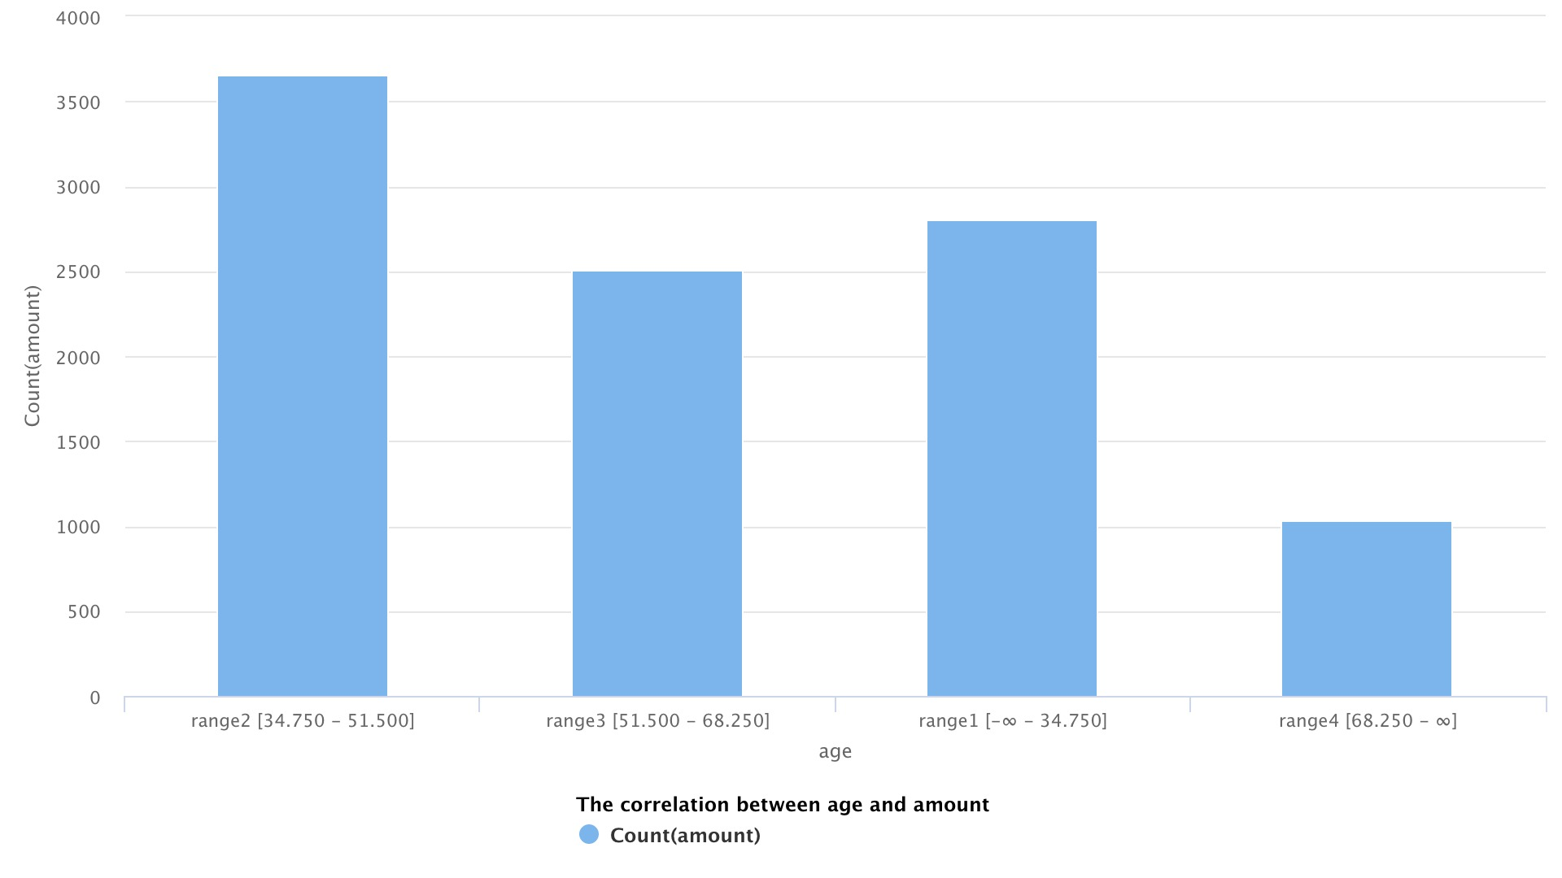
Spending overview – age & region wise
Question:
Are there differences in spend based on the age of customers between regions?
Finding:
Based on region and amount , the analysis indicate a trend that points towards <50 years age group spending more in most of the regions

Slide 9
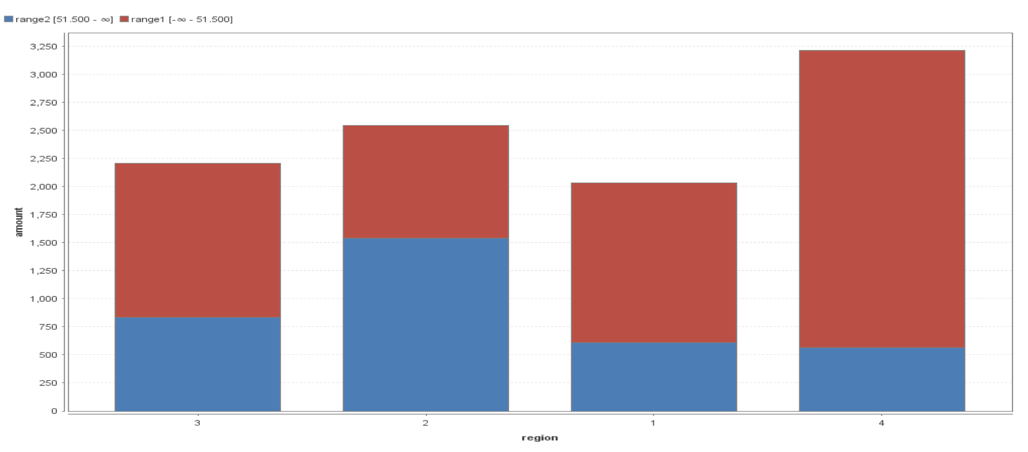

Slide 10
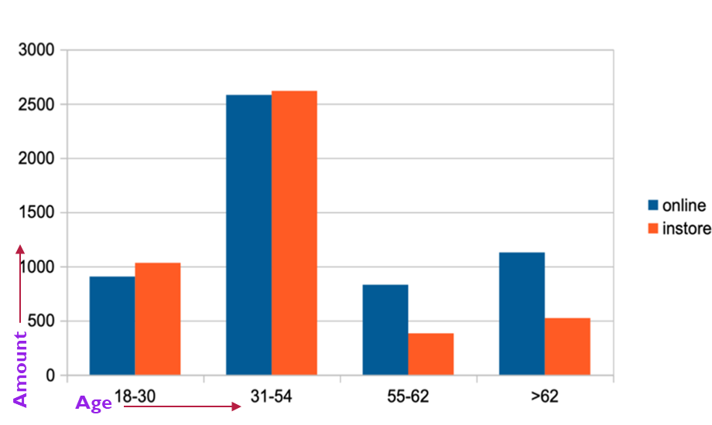
Transaction mode – age wise
Question:
Is there any correlation between age of a customer and the transaction mode – online vs in store?
Finding:
The results, shows that the age group >50 category purchases more online than the age group <50.

Slide 11
New product profitability

Slide 12
PREDICTING PROFITABILITY FOR NEW PRODUCTS
Product Type | Product # | Rank | Brand Name | Price | Profit margin | Sales Volume | Predicted profit
Tablet | 186 | 1 | Apple | $629,00 | 0,1 | 2200,1 | 138384
Laptop | 176 | 2 | Razer | $1 999,00 | 0,23 | 264,1 | 121421
Tablet | 187 | 3 | Amazon | $199,00 | 0,2 | 2298,9 | 91497
PC | 171 | 4 | Dell | $699,00 | 0,25 | 479,6 | 83809
Netbook | 180 | 5 | Acer | $329,00 | 0,09 | 2200,1 | 65144
Classifier | Parameter | RMSE | R Squared
GBT | Number of Trees=100 | 742.53 +/- 1066.32 | 0.902 +/- 0.075
 | Number of folds =10
The Gradient Boosted Trees algorithms provides a good performance if
compared with other approaches such as SVM and KNN .

Slide 13
Product Type | Product # | Rank | Brand Name | Price | Profit margin | Sales Volume | Predicted profit
Tablet | 186 | 1 | Apple | $629,00 | 0,1 | 2200,1 | 138384
Laptop | 176 | 2 | Razer | $1 999,00 | 0,23 | 264,1 | 121421
Tablet | 187 | 3 | Amazon | $199,00 | 0,2 | 2298,9 | 91497
PC | 171 | 4 | Dell | $699,00 | 0,25 | 479,6 | 83809
Netbook | 180 | 5 | Acer | $329,00 | 0,09 | 2200,1 | 65144
PC | 172 | 6 | Dell | $860,00 | 0,2 | 307,4 | 52881
Game Console | 199 | 7 | Sony | $249,99 | 0,09 | 2200,1 | 49500
Laptop | 175 | 8 | Toshiba | $1 199,00 | 0,15 | 264,1 | 47497
Laptop | 173 | 9 | Apple | $1 199,00 | 0,1 | 388,4 | 46570
Netbook | 181 | 10 | Asus | $439,00 | 0,11 | 556,4 | 26867
Smartphone | 193 | 11 | Motorola | $199,00 | 0,11 | 528,8 | 11577
Smartphone | 196 | 12 | Motorola | $300,00 | 0,11 | 299,1 | 9870
Netbook | 178 | 13 | HP | $399,99 | 0,08 | 264,4 | 8462
Netbook | 183 | 14 | Samsung | $330,00 | 0,09 | 264,4 | 7854
Smartphone | 195 | 15 | HTC | $149,00 | 0,15 | 265,9 | 5942
Smartphone | 194 | 16 | Samsung | $49,00 | 0,12 | 659,3 | 3877
Monitor | 201 | 17 | Asus | $140,00 | 0,05 | 264,1 | 1849

Slide 14
Summary and Conclusions
Most of the active online customers belongs to age group of 50-80 years. So, the company has to concentrate more on the customers of age group
of 20-49 years to enhance the online sales.
Result based on age indicates that more focus on the >50 age marketing strategies and ideas to maximize the in-store sales by promotional sales
Could be an idea to divert some of the revenue into sales and marketing for low performing regions .Selection for low performing regions may be based on further data analysis and bench marking
Using existing data, the market possibilities could be predicted for new products.

Slide 15
Data Mining in the future
Forecast the performance of the product(s) in the market.
Customer segmentation e.g. for targeted marketing
New revenue streams can be analyzed
Easy to understand patterns and other related risks factors
Collaborative filtering (group based on common items purchased)
Given database of user preferences, predict preference of new user
Improve predictive capability of classifiers that assume attribute independence

Slide 16
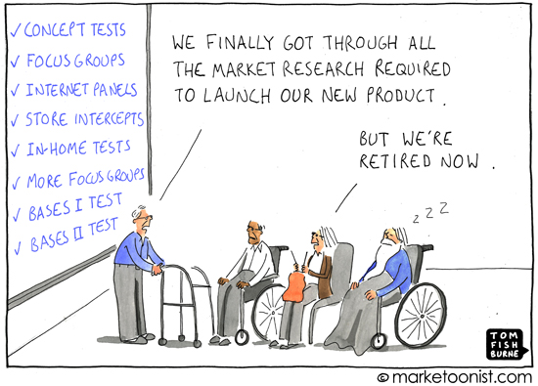

Slide 17
Thank you !

